Slide 1
Impact of Lab Effects and Environment on Audiovisual Quality
Margaret H. Pinson

Slide 2
Goal
Investigate interactions:
Testing Laboratory
Experiment Environment
Audiovisual Quality MOS
Preliminary
Small test – what we can do easily
Insights – learn scope of problem
Help design follow-on experiments
Do what is easy
Run subject with another subjective experiment
Use environment have available

Slide 3
Questions
How repeatable are audiovisual subjective tests from lab to lab in a pristine environment (e.g., ITU-R Rec. BT.500, ITU-T P.911, sound isolation room)
How are critical are the currently agreed upon pristine environmental constraints? For example, what if a quiet room is used instead of a sound isolation room?
How are audiovisual MOS impacted by conducting the experiment on location (e.g., in a cafeteria or at a café).
Is data from red-green colorblind people is indistinguishable from other subjects?
What is the impact of language on MOS? For example, English speech with subjects who are not fluent in English.

Slide 4
Design
Small VGA Subjective Test
10 SRC
5 HRCs + original
Three audio impairment levels (original, fair, bad)
Three video impairment levels (original, fair, bad)
Multiple VQEG Testing Labs
Different Environments
Pristine Lab
Good Lab
On Location – cafeteria, bus stop, home, park

Slide 5
Design
Source Video
2 music video
2 simulated news with background noise
Choreographed band on grass field
Boxing demonstration
Unprofessional musicians
2 animation
Test Software
Lightly compressed clips
Reliable playback on any computer
ACR

Slide 6
NTIA Environment - Laboratory
Pristine Laboratory
Sound isolation booth
Compliant with P.800 noise levels
Compliant with ITU-R BT.500
Professional grade LCD television
Professional grade speakers
27 Subjects brought in for a different experiment
Noncompliant as follows:
Speakers behind subject
No backlighting
Light color temperature close but not exact
Monitor calibration for LCD (not CRT)

Slide 7
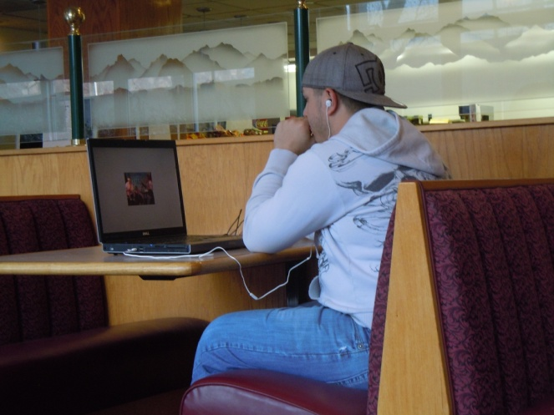
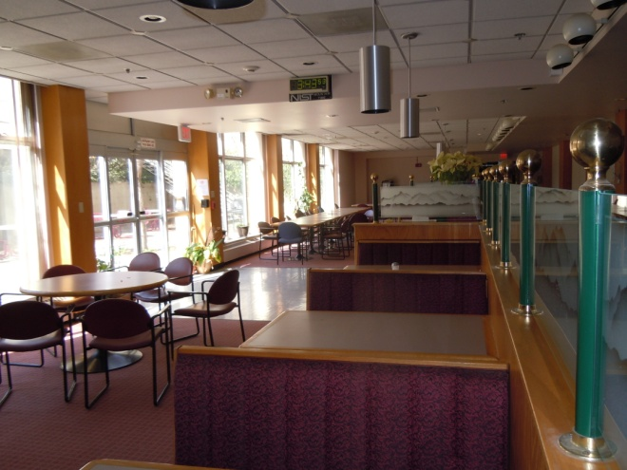
NTIA Environment - Cafeteria
Office cafeteria
Soft music plus noise from cafeteria patrons
Natural light plus fluorescent light
Laptop with ear buds – 1920x1200 resolution screen
Manufacturer default video levels
12 subjects

Slide 8
NTIA Environments – 0.95 Correlation

Slide 9
Can you run subjects?
CD with everything you need
Goal – repeat test in a variety of environments
Pristine lab
Nearly pristine lab
Close to pristine (e.g., BT.500 but not P.800)
Simulated location
On location
Want subjective data by end of July
Paper by end of September

